Slide 1
Group 47
Bhaskar Pegu 20D100006
Sikchi Madhur Manoj 20D100027
Subrat Raj 200100150
Classification Of Image By Segmentation Using K-Means Clustering And GLCM Feature Extraction

Slide 2
Introduction
We have performed object based image analysis on a single image.
Image is segmented using K mean clustering and then using GLCM feature for classification into regions using Random Forests classifier.

Slide 3
Problem Specification
Segment an image using K-means clustering
Select samples and extract GLCM texture feature
We have an image and we have to finally classify the image into different regions by highlighting different regions. The classification into regions is done according to their properties and category.

Slide 4
Strategy for the solution:
Pre-processing
Image Segmentation
Feature Extraction
Image Classification
Grayscale conversion and smoothing to reduce the noise.
Segmentation is done on the image using K-means clustering
Feature extraction is done by calculating the GLCM for training data points
Use the trained model to test and predict the classes for the complete image to obtain a classified image

Slide 5
Solution Strategy Contd.
The first step is importing and read the RGB image and converting it to grayscale image.
Then we use gaussian blur on the image to reduce any noise present in the image.
Then we segmented image using K-means clustering.
Now, GLCM calculation is done for the whole image. Then samples are selected for the image and the GLCM corresponding to the sample positions is obtained from the original GLCM matrix.

Slide 6
Solution Strategy Contd.
Contrast, homogeneity and energy features were calculated using GLCM of the samples.
Then the model was trained on the samples using Random Forests Classifier and we obtained a final classified image.
Note: GLCM calculation is very heavy. So, we have calculated and provided a GLCM , so that time is saved by using the same GLCM every time.

Slide 7
User input Parameters
The user input parameters are:
Number of clusters (k), maximum no. of iterations, epsilon for k-means.
Window size, number of angles, and distances are parameters for GLCM.
Sample Size (in number of pixels)
RF parameters

Slide 8
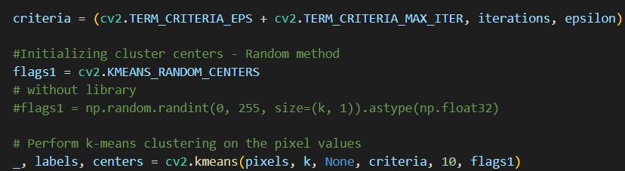
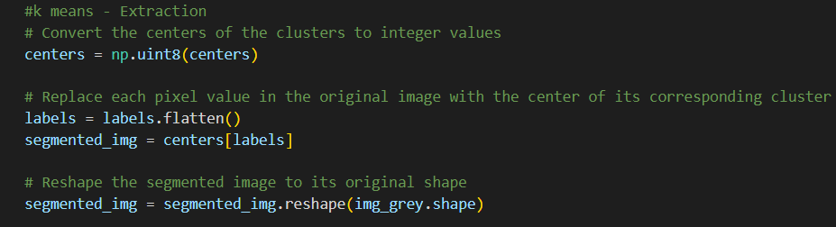
Code Snippets (K-means)

Slide 9
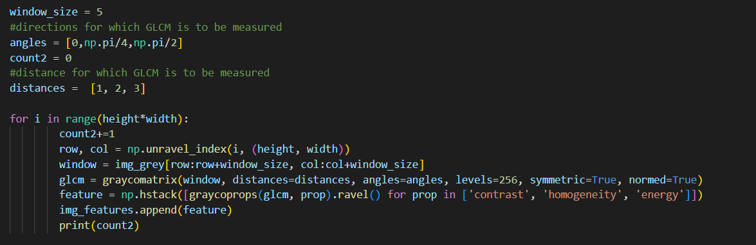
Code Snippets (GLCM)

Slide 10
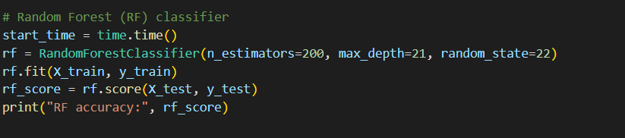
Code Snippets (Random Forests)

Slide 11
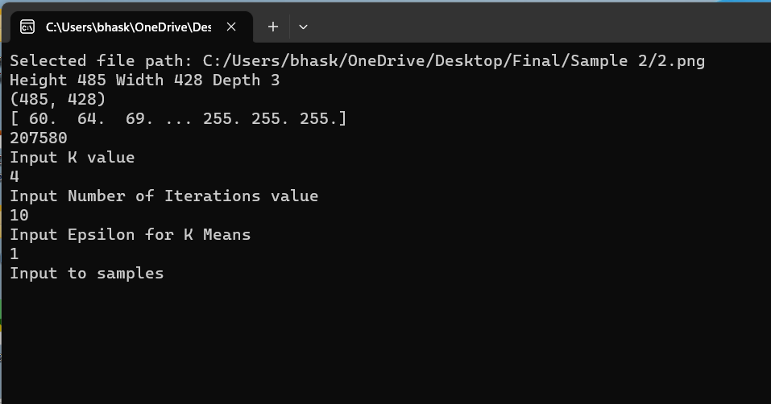
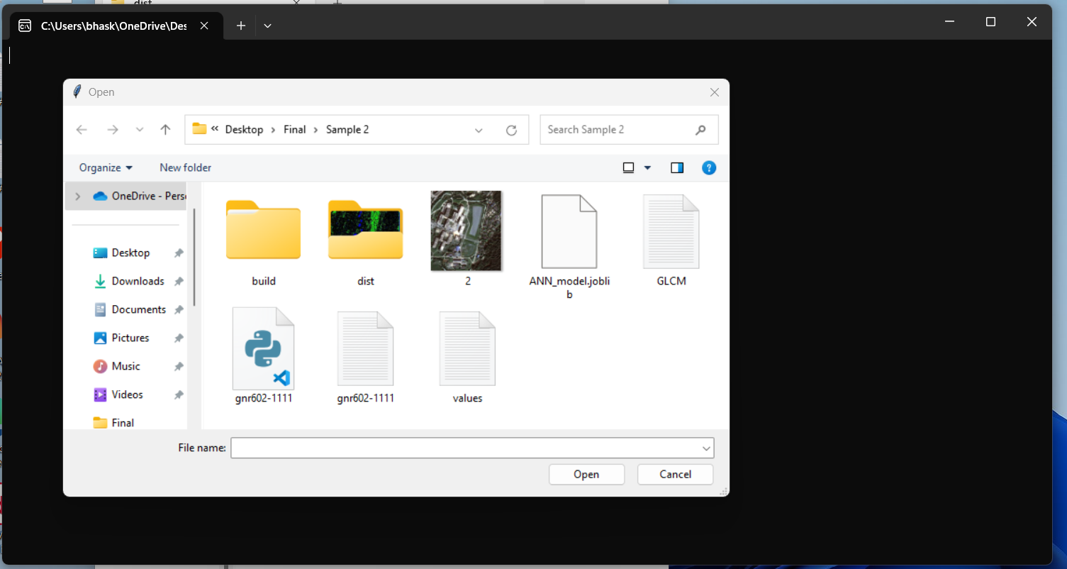
Screenshot of GUI

Slide 12
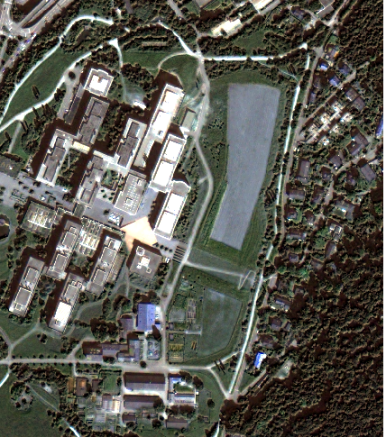
Input Data 1
Input file 1
Image size = (485,428)

Slide 13
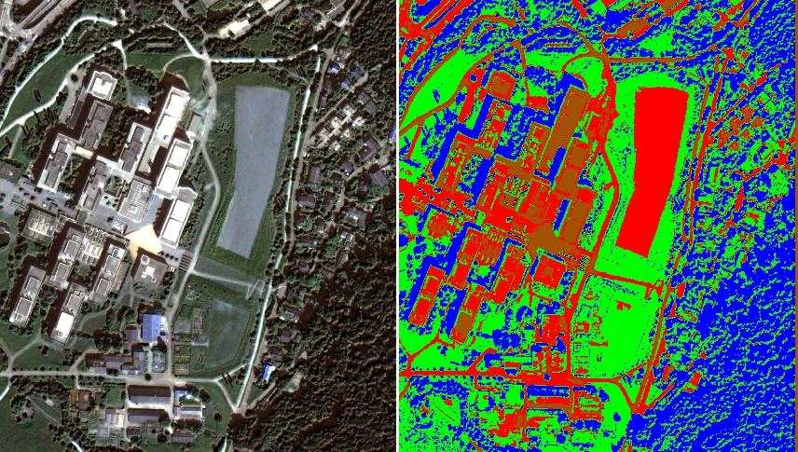
Original and Segmented (Param set 1)
GLCM parameters
Distances = 3
Angles = 3
K Means
Clusters = 4
Samples
4x4000

Slide 14
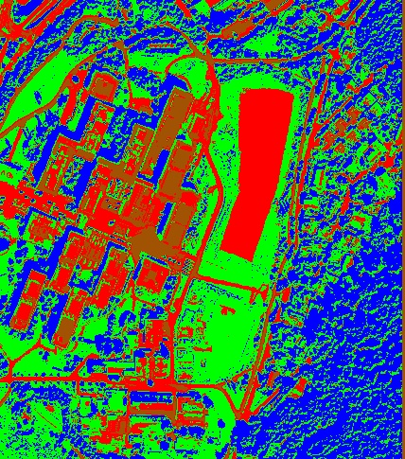
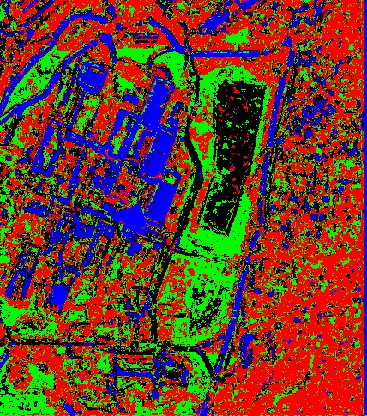
Segmented and Classified Images (param set 1)
RF_score = 56%

Slide 15

Original and Segmented (param set 2)
GLCM parameters
Distances = 3
Angles = 3
K Means
Clusters = 4
Samples
4x10000

Slide 16
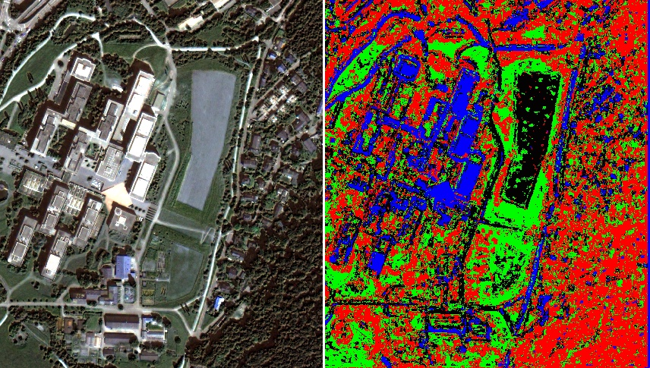
Segmented and Classified Images (param set 2)
RF_score = 61%

Slide 17
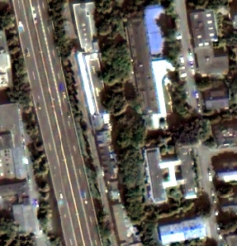
Input Data 2
Input File 2
Image size = (297,287)

Slide 18
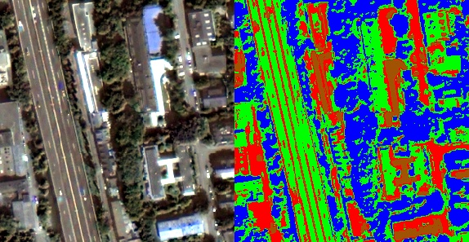
Original vs segmented (parameter set 1)
GLCM parameters
Distances = 3
Angles = 3
K Means
Clusters = 4
Samples
4x2000

Slide 19
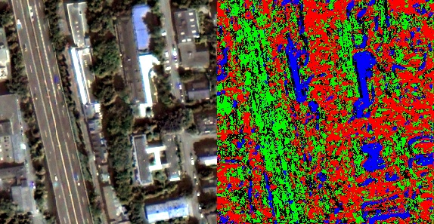
Original and Classified images (Parameter Set 1)
RF_score = 51%

Slide 20
Original vs segmented (parameter set 2, without blur)
GLCM parameters
Distances = 4
Angles = 4
K Means
Clusters = 4
Samples
4x3000

Slide 21
Original and Classified images (Parameter Set 2, no blur)
RF_score = 55%

Slide 22
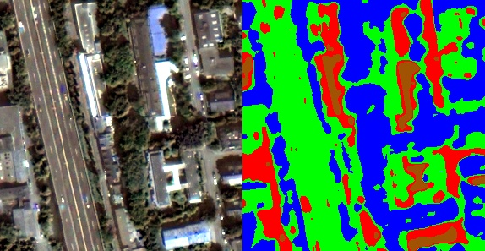
Original vs segmented (parameter set 2 with blur)
GLCM parameters
Distances = 4
Angles = 4
K Means
Clusters = 4
Samples
4x3000
Median Blur used - Window 9

Slide 23
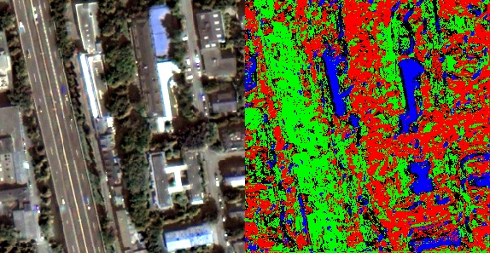
Original and Classified images (Parameter Set 2 with blur)
RF_score = 61%

Slide 24
References:
https://github.com/manideep2510/eye-in-the-sky
https://www.javatpoint.com/k-means-clustering-algorithm-in-machine-learning
https://support.echoview.com/WebHelp/Windows_And_Dialog_Boxes/Dialog_Boxes/Variable_Properties_Dialog_Box/Operator_Pages/GLCM_Texture_Features.htm
https://ceholden.github.io/open-geo-tutorial/python/chapter_5_classification.html

